Slide 1



University of Basra
College of Nursing
Psychiatric Mental Health Nursing
Personality Disorders

Slide 2
Personality is ingrained, enduring pattern of behaving and relating to the self, others, and the environment; it includes perceptions, attitudes, and emotions

Slide 3
Personality disorders are diagnosed when there is impairment of personality functioning and personality traits that are maladaptive. Individuals have identity problems such as egocentrism, or being self-centered, and their sense of self-esteem comes from gaining power or pleasure that is often at the expense of others.
Personality disorders are not diagnosed until adulthood, that is, at age 18, when personality is more completely formed

Slide 4
Individuals with a personality disorder may include:
Negative behaviors toward others, such as being manipulative, dishonest,
deceitful, or lying
• Anger and/or hostility
• Irritable, labile moods
• Lack of guilt or remorse, emotionally cold and uncaring
• Impulsivity, distractibility, poor judgment
• Irresponsible, not accountable for own actions
• Risk-taking, thrill-seeking behaviors
• Mistrust
• Exhibitionism
• Entitlement
• Dependency, insecurity
• Eccentric perceptions

Slide 5
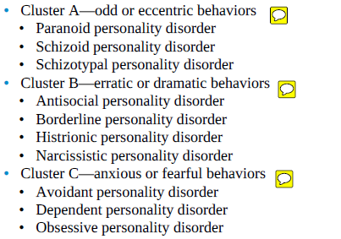
Classifications (DSM-5 –P.D. classified for 3 “clusters”)

Slide 6
Other Behaviors
Other clusters of behavior related to maladaptive personality traits include:
• Depressive behavior is characterized by a pervasive pattern of depressive cognitions and behaviors in various contexts. It occurs more often in people with relatives who have major depressive disorders. People with depressive personality disorders often seek treatment for their distress.
• Passive-aggressive behavior is characterized by a negative attitude and a pervasive pattern of passive resistance to demands for adequate social and occupational performance. These clients may appear cooperative, even ingratiating, or sullen and withdrawn, depending on the circumstances. Their mood may fluctuate rapidly and erratically, and they may be easily upset or offended.

Slide 7
Onset and Clinical Course
Personality disorders are relatively common, occurring in 10% to 20% of the general population.
Incidence is even higher for people in lower socioeconomic groups and unstable or disadvantaged populations.
Of all psychiatric inpatients, 15% have a primary diagnosis of a personality disorders
A primary diagnosis of major mental illness, 40- 45% also have a coexisting personality disorder
The incidence of personality disorder in mental health outpatient settings is 30- 50%
Clients with personality disorders have a higher death rate, especially as a result of suicide; they also have higher rates of suicide attempts, accidents, and emergency department visits, and increased rates of separation, divorce, and involvement in legal proceedings regarding child custody. Personality disorders have been highly correlated with criminal behavior, alcoholism, and drug abuse.

Slide 8
ETIOLOGY
A. Biologic Theories
Personality develops through the interaction of hereditary dispositions and environmental influences. Temperament refers to the biologic processes of sensation, association, and motivation that underlie the integration of skills and habits based on emotion. Genetic differences account for about 50% of the variances in temperament traits.
The four temperament traits are harm avoidance, novelty seeking, reward dependence, and persistence. Each of these four genetically influenced traits affects a person’s automatic responses to certain situations. These response patterns are ingrained by 2 to 3 years of age.

Slide 9
B. Psychodynamic Theories
social learning, culture, and random life events unique to each person influence character. Character consists of concepts about the self and the external world. It develops over time as a person comes into contact with people and situations and confronts challenges. Three major character traits have been distinguished: selfdirectedness, cooperativeness, and self-transcendence.

Slide 10
Treatment
Several treatment strategies are used with clients with personality disorders; these strategies are based on the disorder’s type and severity or the amount of distress or functional impairment the client experiences.
A. Psychopharmacology
Pharmacologic treatment of clients with personality disorders focuses on the client’s symptoms rather than the particular subtype. The four symptom categories that underlie personality disorders are cognitive–perceptual distortions, including
psychotic symptoms
affective symptoms and mood dysregulation
aggression and behavioral dysfunction
anxiety

Slide 11
. Lithium, anticonvulsant mood stabilizers, and benzodiazepines are used most often to treat aggression. Low dose neuroleptics may be useful in modifying predatory aggression.
Emotional instability and mood swings respond favorably to lithium, carbamazepine (Tegretol), valproate (Depakote), or low-dose neuroleptics such as haloperidol (Haldol). Emotional detachment, cold and aloof emotions, and disinterest in social relations often respond to selective serotonin reuptake inhibitors (SSRIs) or atypical antipsychotics such as risperidone (Risperdal), olanzapine (Zyprexa), and quetiapine (Seroquel). Atypical depression is often treated with SSRIs, monoamine oxidase inhibitor (MAOI) antidepressants, or lowdose antipsychotic medications.
Emotional Episodes of severe acute anxiety are best treated with MAOIs or low-dose antipsychotic medications.

Slide 12
B. Individual and Group Psychotherapy
Individual and group psychotherapy goals for clients with personality disorders focus on building trust, teaching basic living skills, providing support.
Relaxation or meditation techniques can help manage anxiety for clients.
Assertiveness training groups can assist people to have more satisfying relationships with others and to build self-esteem when that is needed.
Cognitive–behavioral therapy by:
Thought stopping, in which the client stops negative thought patterns
Positive self talk, designed to change negative self-messages; and decatastrophizing,

Slide 13
1. PARANOID PERSONALITY DISORDER
Paranoid personality disorder is characterized by pervasive mistrust and suspiciousness of others
2. SCHIZOID PERSONALITY DISORDER
Schizoid personality disorder is characterized by a pervasive pattern of detachment from social relationships and a restricted range of emotional expression in interpersonal settings
3. SCHIZOTYPAL PERSONALITY DISORDER
Schizotypal personality disorder is characterized by a pervasive pattern of
social and interpersonal deficits marked by acute discomfort with and reduced capacity for close relationships as well as by cognitive or perceptual distortions and behavioral eccentricities.

Slide 14
4. ANTISOCIAL PERSONALITY DISORDER
Antisocial personality disorder is characterized by a pervasive pattern of disregard for and violation of the rights of others—and by the central characteristics of deceit and manipulation. This pattern has also been referred to as psychopathy, sociopathy, or dyssocial personality disorder.
It occurs in about 3% of the general population, up to 30% in clinical settings, and is three to four times more common in men than in women.
In prison populations, about 75% are diagnosed with antisocial personality disorder.
Antisocial behaviors tend to peak in the 20s and diminish significantly after 45 years of age in many individuals.

Slide 15
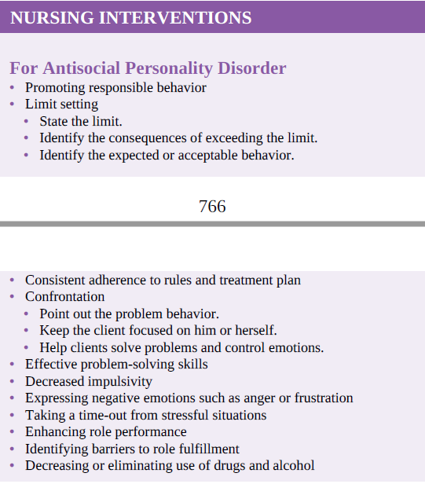

Slide 16
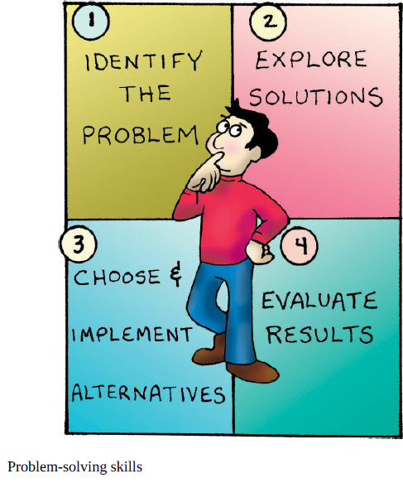

Slide 17
5. BORDERLINE PERSONALITY DISORDER
BPD is characterized by a pervasive pattern of unstable interpersonal relationships, self-image, and affect as well as marked impulsivity.
About 2% to 3% of the general population has BPD; it is five times more common in those with a first-degree relative with the diagnosis.
BPD is the most common personality disorder found in clinical settings.
It is three times more common in women than in men.
Under stress, transient psychotic symptoms are common. Between 8% and 10% of people with this diagnosis commit suicide, and many more suffer permanent damage from self-mutilation injuries, such as cutting or burning.
Up to three-quarters of clients with BPD engage in deliberate self-harm, sometimes called nonsuicidal self-injury
The pervasive mood is dysphoric, involving unhappiness, restlessness, and malaise

Slide 18
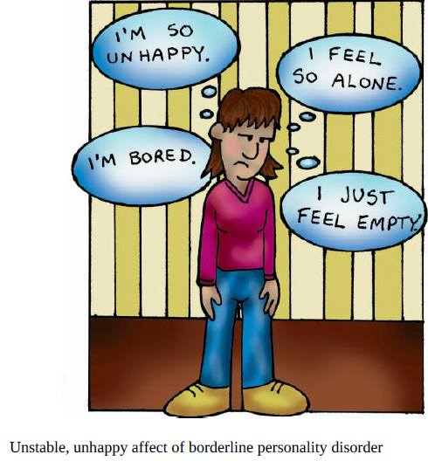

Slide 19
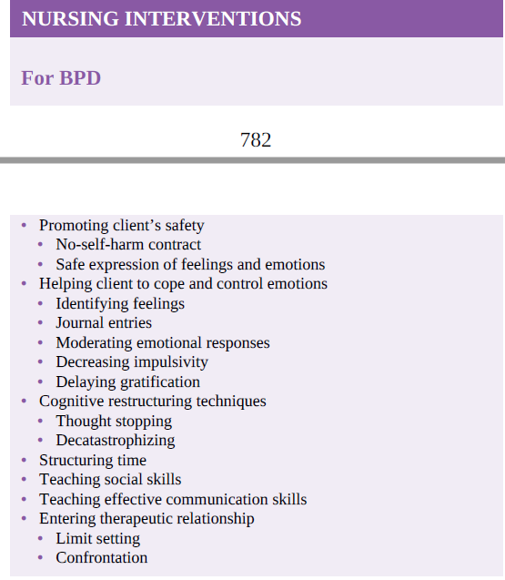

Slide 20
6. NARCISSISTIC PERSONALITY DISORDER
Narcissistic personality disorder is characterized by a pervasive pattern of grandiosity (in fantasy or behavior), need for admiration, and lack of empathy.
It occurs in 1% to 6% of the general population.
Of people with this diagnosis, 50% to 75% are men. Narcissistic traits are common in adolescence and do not necessarily indicate that a personality disorder will develop in adulthood.
Individual psychotherapy is the most effective treatment, and hospitalization is rare unless comorbid conditions exist for which the client requires inpatient treatment

Slide 21
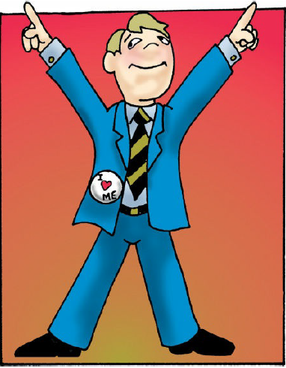
Clients may display:
An arrogant or haughty attitude.
lack the ability to recognize or empathize with the feelings of others
They may express envy and begrudge others any recognition or material success because they believe it rightfully should be theirs.
They may express their grandiosity overtly, or they may quietly expect to be recognized for their perceived greatness.\
They are often preoccupied with fantasies of unlimited success, power, brilliance, beauty, or ideal love
Thought processing is intact, but insight is limited or poor
Clients believe themselves to be superior and special
At work, these clients may experience some success because they are ambitious and confident
The nurse must use self-awareness skills to avoid the anger and frustration that these clients’ behavior and attitude can engender.

Slide 22
8. AVOIDANT PERSONALITY DISORDER
7. HISTRIONIC PERSONALITY DISORDER
Histrionic personality disorder is characterized by a pervasive pattern of excessive emotionality and attention seeking
Avoidant personality disorder is characterized by a pervasive pattern of social discomfort and reticence, low self-esteem, and hypersensitivity to negative evaluation. It occurs in 2% to 3% of the general population
9. DEPENDENT PERSONALITY DISORDER
Dependent personality disorder is characterized by a pervasive and excessive need to be taken care of, which leads to submissive and clinging behavior and fears of separation.
10. OBSESSIVE–COMPULSIVE PERSONALITY DISORDER
Obsessive–compulsive personality disorder is characterized by a pervasive Pattern of preoccupation with perfectionism, mental and interpersonal control, and orderliness at the expense of flexibility, openness, and efficiency.

Slide 23



